Slide 1
Cyclones for Africa
September 2026

Slide 2
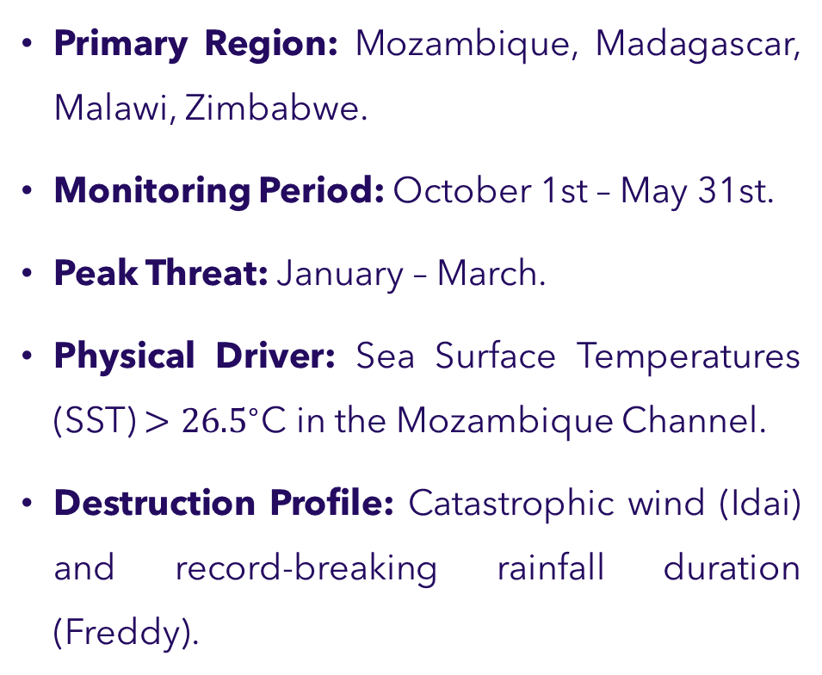
Tropical Cyclone Window (SE Africa)
Temperate Cyclone Window (The Winter Risk)
Primary Region: Mozambique, Madagascar, Malawi, Zimbabwe.
Monitoring Period: October 1st – May 31st.
Peak Threat: January – March.
Physical Driver: Sea Surface Temperatures (SST) $>{26.5}^{∘}\text{C}$ in the Mozambique Channel.
Destruction Profile: Catastrophic wind (Idai) and record-breaking rainfall duration (Freddy).
Observation Window A (South Africa): May – September.
  Focus: Western Cape, Eastern Cape.
  Driver: Antarctic Westerlies moving North.
Observation Window B (North Africa): November – March.
  Focus: Morocco, Algeria, Libya, Egypt.
  Driver: Cold European air over the Mediterranean.
Notes:
Primary Trigger: Minimum MSLP $<995\text{ hPa}$ + Max Sustained Wind Speed.
Primary Trigger: MSLP Drop + Rapid Temperature Decrease ($5^{∘}\text{C}$/24h)

Slide 3
Cyclone Window
Continuous 47-Year Hazard Monitoring (1980–2026): Hourly ECMWF ERA5 reanalysis across all African districts.
Synoptic 72-Hour Reinsurance Event Window: Once peak gusts reach ≥ 63 km/h, a 72-hour window groups continuous storm hours into a single event. Selected based on physical cyclone landfall duration and inland dissipation decay (WMO No. 1194; Kaplan & DeMaria, 1995).
Sector-Specific Windows:
◦ Agricultural In-Season: Following the active growing cycles (Planting to Harvest DOY across 2,066 districts; 186 events).
◦ Commercial Property: Monitored across all 365 calendar days, capturing both SWIO summer cyclones and Mediterranean winter gales (210 events).
Notes:
Primary Trigger: Peak 10m Wind Gust (ee.Reducer.max) ≥ 63 km/h (Agro In-Season) / ≥ 119 km/h (Property Full-Year) + Kerry Emanuel PDI ($V^3$)

Slide 4
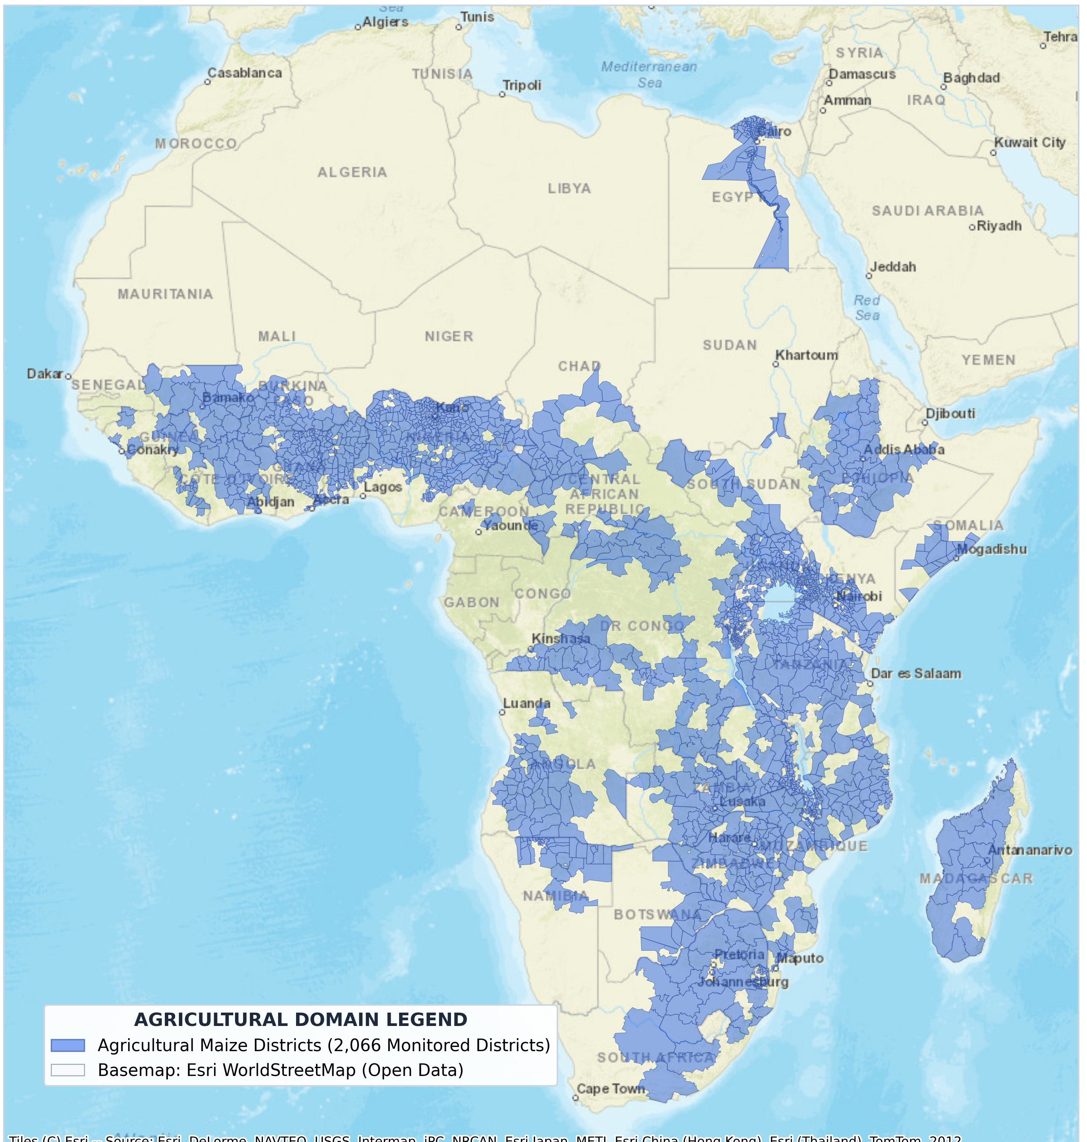
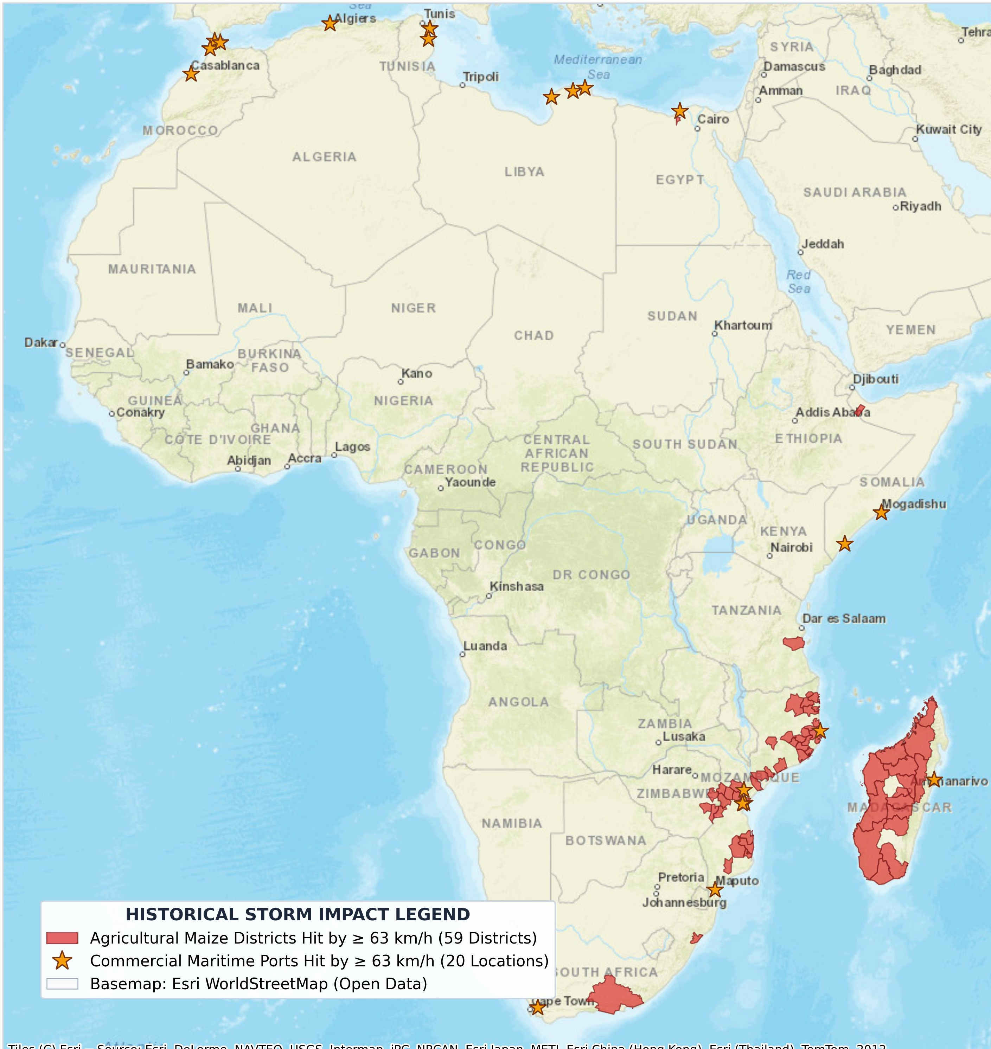
Study Area:
Agricultural districts for crop season monitoring.
Kept districts hit by windspeed (wind_gust_since_previous_post_processing_10m >= 34 kt / 63 km/h).

Slide 5
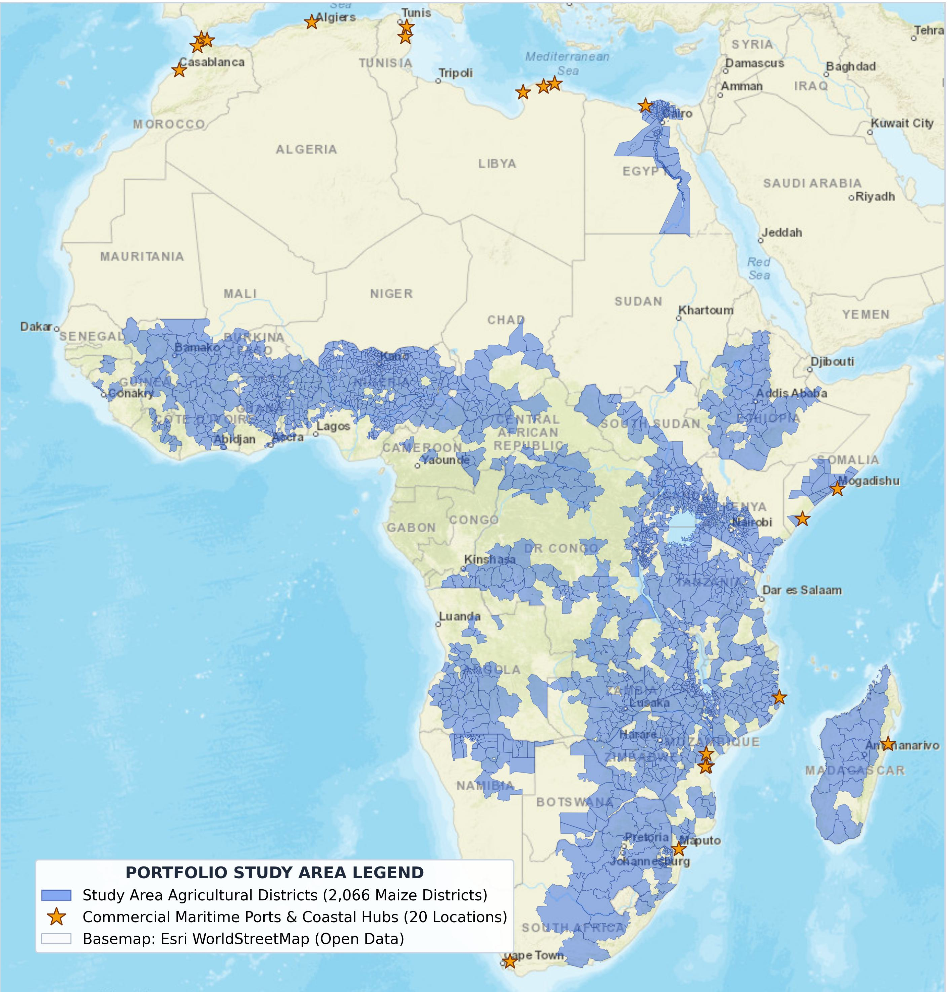
Contd.
This prevents us from under representing high-value urban corridors or non-maize agricultural zones, providing a more comprehensive view of cyclone risk in Africa.

Slide 6
Data:
ERA5: ECMWF ERA5 Hourly on Single Levels (Google Earth Engine: ECMWF/ERA5/HOURLY)
Variable:wind_gust_since_previous_post_processing_10m (m/s)
Spatial Resolution: 0.25 degrees (~31 km at the equator)
Temporal Resolution: Hourly
Coverage: Global, from 1940 to present

Slide 7
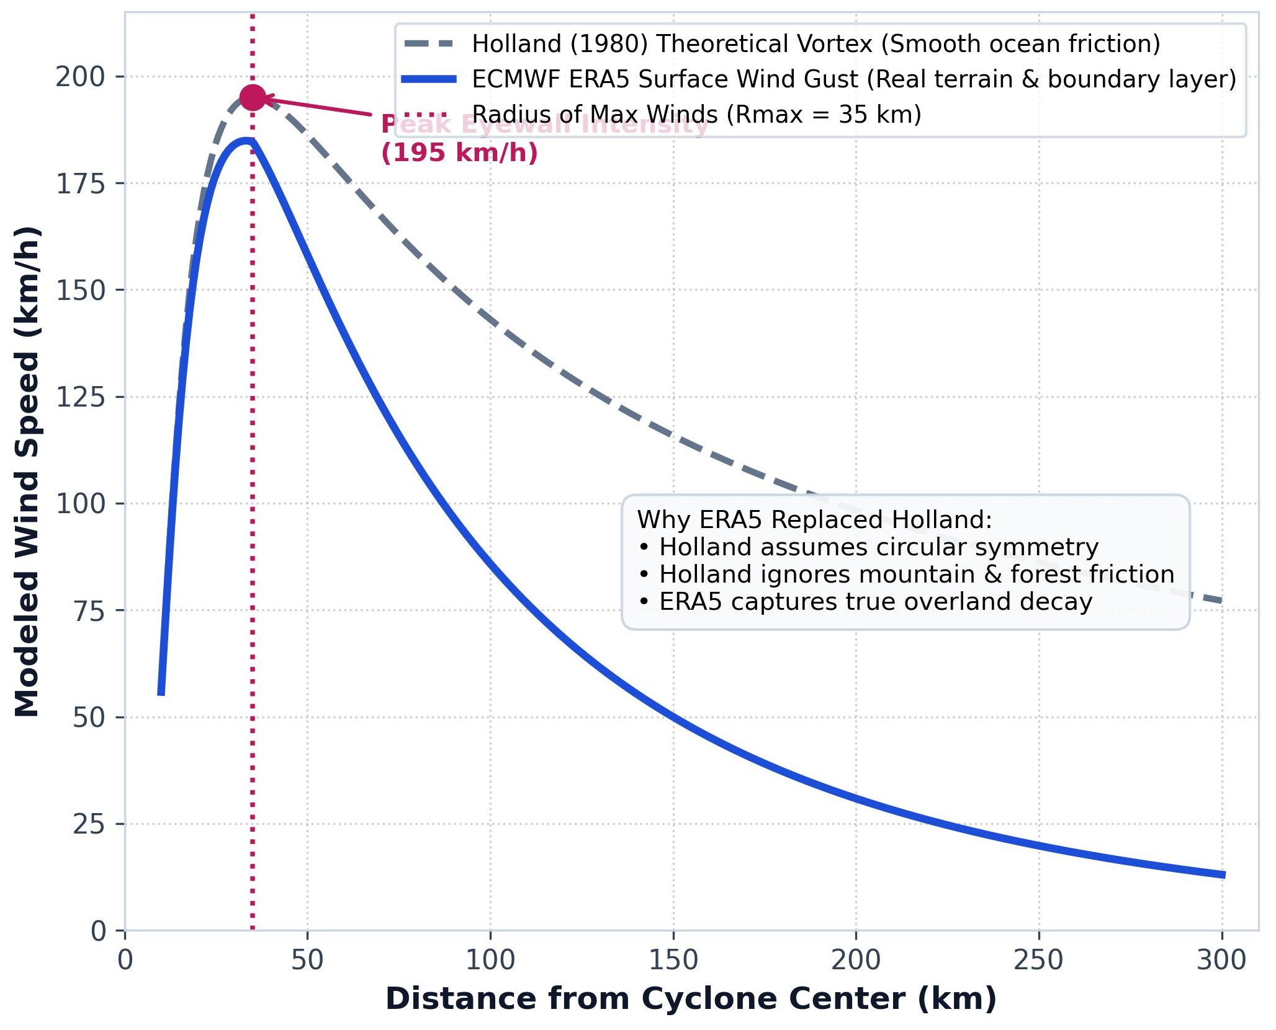
ECMWF ERA5 Reanalysis vs. Holland Model
Limitations of the Holland (1980) Vortex Model:
  Ignores real land friction, mountains, and local terrain roughness.
  Only works for officially declared tropical cyclones.
Why We Standardized on ECMWF ERA5 Instantaneous Wind Gust:
  Direct Physical Measurement: Provides continuous hourly wind speeds at 10 meters height across all 2,086 districts.
  Validated Against Ground Stations: During Cyclone Idai at Beira Airport, ERA5 recorded 147.8 km/h, closely matching official ground station readings of 150–165 km/h.
  Unified Pan-African Coverage: Covers both Southern African tropical cyclones and North African Mediterranean gales consistently across 47 full years (1980–2026).
Notes:
Underwriting Benefit:
Eliminates model uncertainty and track interpolation errors, giving reinsurers an objective, independently audited dataset for claim payouts.
However, Holland is a theoretical circular formula that misses terrain friction and only covers named tropical storms.
We instead standardized on ECMWF ERA5 instantaneous wind gusts it directly captures actual physical wind speed across the entire continent, was verified against ground stations like Beira during Cyclone Idai, and provides 47 years of complete, uninterrupted data for underwriting.

Slide 8
Mathematical Formulations:
Step 1: District Peak Wind Speed
Formula: District Peak Wind = Maximum Wind Speed recorded anywhere inside the district boundary
Step 2: 72-Hour Reinsurance Event Window
Formula: Event Window = (24 Hours Before Peak) to (48 Hours After Peak) = 72 Hours Total
Step 3: Kerry Emanuel Power Dissipation Index (PDI)
Formula: Excess Wind Speed = Maximum of (0, Wind Speed - Threshold)
PDI = Sum of (Excess Wind Speed)³ ÷ 1,000
Explanation: Wind damage does not increase in a straight line it cubes. For example, a 120 km/h wind causes roughly 8 times more destruction than a 60 km/h wind. Cubing the excess wind speed reflects real physical destruction to roofs and crops.
Step 4: Dual-Sector Payout Triggers
Agriculture (Crop Lodging Trigger): Payout = YES, if Wind Speed >= 63 km/h AND Date is between Planting and Harvest
Commercial Property & Ports (Structural Damage Trigger):
Payout = YES, if Wind Speed >= 119 km/h (Category 1 Hurricane Force)
Notes:
Step 1: District Peak Wind Speed
Formula: District Peak Wind = Maximum Wind Speed recorded anywhere inside the district boundary
Plain Explanation: Captures the strongest gust inside the entire district polygon (the eyewall) rather than just looking at the center point.
Step 2: 72-Hour Reinsurance Event Window
Formula: Event Window = (24 Hours Before Peak) to (48 Hours After Peak) = 72 Hours Total
Plain Explanation: Groups hourly winds into a single 3-day storm event to match standard reinsurance contracts and prevent double-counting claims.
Step 3: Kerry Emanuel Power Dissipation Index (PDI)
Formula: Excess Wind Speed = Maximum of (0, Wind Speed - Threshold)
PDI = Sum of (Excess Wind Speed)³ ÷ 1,000
Plain Explanation: Wind damage does not increase in a straight line—it cubes. For example, a 120 km/h wind causes roughly 8 times more destruction than a 60 km/h wind. Cubing the excess wind speed reflects real physical destruction to roofs and crops.
Step 4: Dual-Sector Payout Triggers
Agriculture (Crop Lodging Trigger): Payout = YES, if Wind Speed >= 63 km/h AND Date is between Planting and Harvest
(Dry season winds on empty fields do not trigger a payout)
Commercial Property & Ports (Structural Damage Trigger):
Payout = YES, if Wind Speed >= 119 km/h (Category 1 Hurricane Force)
(Monitored 365 days a year across the entire calendar)

Slide 9
Saffir-Simpson Wind Scale
Category | Sustained Winds | Types of Damage Due to Hurricane Winds
1 | 74-95 mph 64-82 kt 119-153 km/h | Minimal. Minor damage to roofs, shingles, and siding. Large tree branches snap; shallow trees topple. Power outages last several days.
2 | 96-110 mph 83-95 kt 154-177 km/h | Moderate. Major roof and siding damage to frame homes. Many trees snapped or uprooted, blocking roads. Near-total power loss for several weeks.
3 (major) | 111-129 mph 96-112 kt 178-208 km/h | Extensive. Major damage to roof decking and building gables. Numerous trees uprooted. Electricity and water are often unavailable for several weeks.
4 (major) | 130-156 mph 113-136 kt 209-251 km/h | Extreme. Severe damage to roof structures and loss of exterior walls. Most trees and power poles downed, isolating residential areas. Most of the area becomes uninhabitable for months.
5 (major) | 157 mph or higher 137 kt or higher 252 km/h or higher | Catastrophic. Total roof failure and complete wall collapses; most homes destroyed. Widespread vegetation and utility destruction. Long-term displacement and uninhabitable conditions for many months.

Slide 10
References:
WMO (2022) TCP-12 Operational Plan. Defines the legal October–May Tropical Season.
Munnick, R., et al. (2020). Established the seasonality of Temperate systems and the "Winter Rainfall Zone."
Fitchett & Grab (2014). Provided the 66-year baseline for South-East African track analysis.
Holland, G. J. (1980). An Analytic Model of the Wind and Pressure Profiles in Hurricanes. Monthly Weather Review, 108(8), 1212–1223. [DOI: 10.1175/1520-0493(1980)108<1212:AAMOTW>2.0.CO;2]
CCRIF SPC. (2019). SPHERA: A System for Probabilistic Hazard Evaluation and Risk Assessment — Tropical Cyclone Hazard Model Technical Manual. Caribbean Catastrophe Risk Insurance Facility.
World Bank & GFDRR. (2020). Methodology for Parametric Risk Modeling of Tropical Cyclones in Developing Nations. Disaster Risk Financing and Insurance Program (DRFIP), Washington, D.C.
Emerton, R., et al. (2020). Emergency capacity building for tropical cyclones using satellite track data and parametric wind models in Mozambique. Geophysical Research Letters, 47(14), e2020GL088289.
Knapp, K. R., et al. (2010). The International Best Track Archive for Climate Stewardship (IBTrACS): Unifying tropical cyclone data. Bulletin of the American Meteorological Society, 91(3), 363–378.

